Slide 1
Verification of Viscous Axisymmetric Formulation in SU2
Jacob Needels and Wally Maier
December 2nd, 2020

Slide 2
Overview
Flow around 3D axisymmetric bodies can be accurately simulated by adding additional source terms to the 2D planar formulation to account for relaxation effects
Implementation motivated by reduction in computational expense for 3D simulations
Scope
Implementation of viscous axisymmetric source terms
Verification across range of Ma and Re

Slide 3
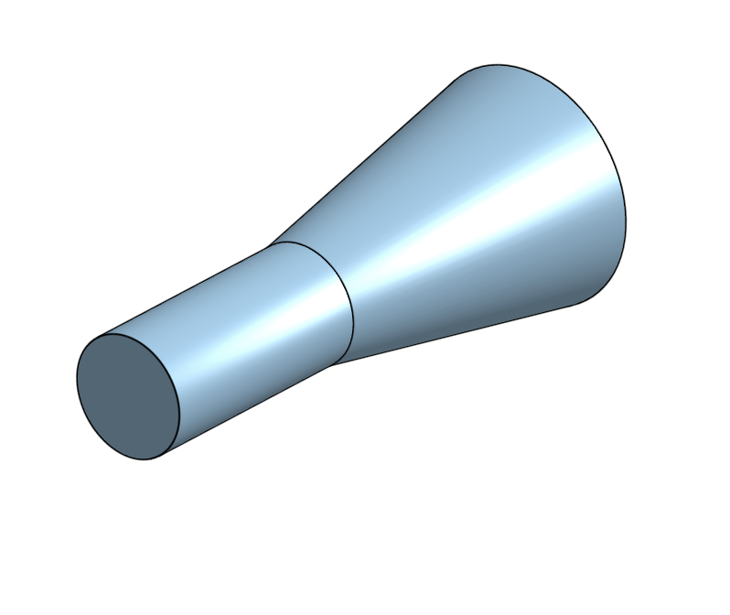
High-Speed Flow over Frustum
Parameter | Value
Ma | 5.0
Re | 10⁴
Cone Angle | 10 deg
$$U_{∞}$$

Slide 4
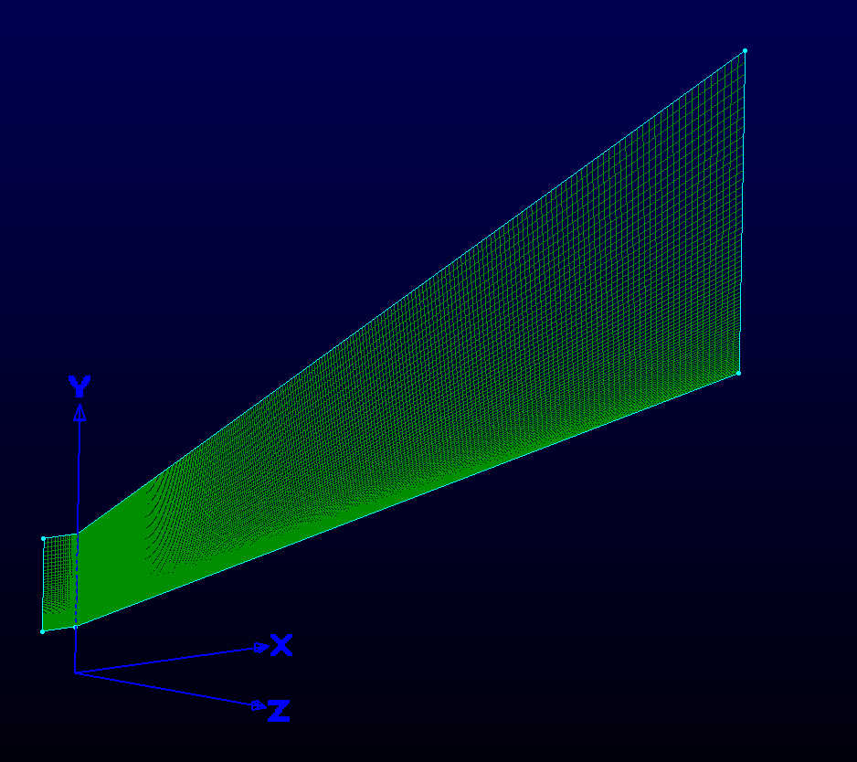
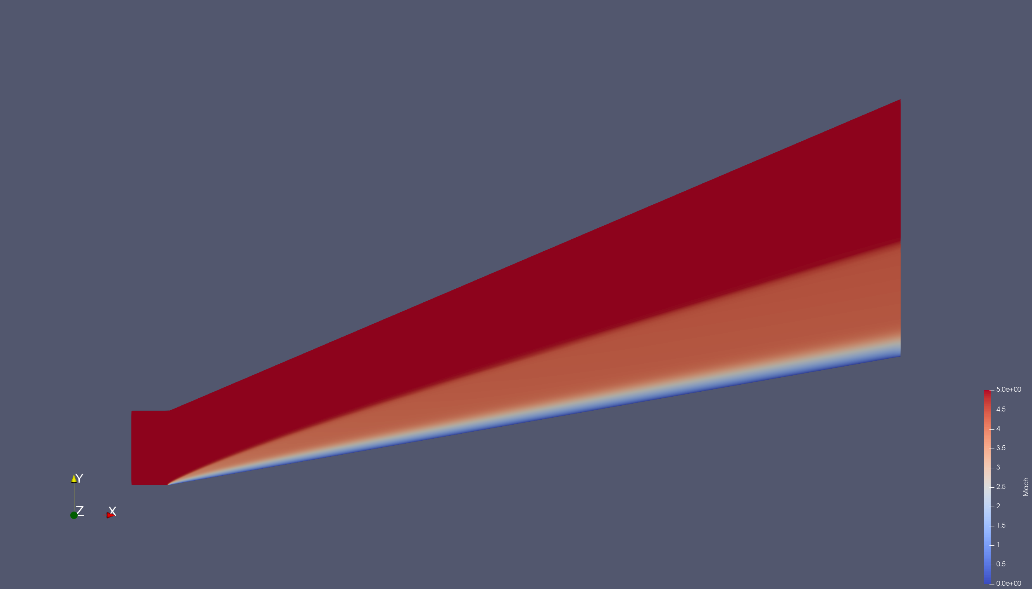
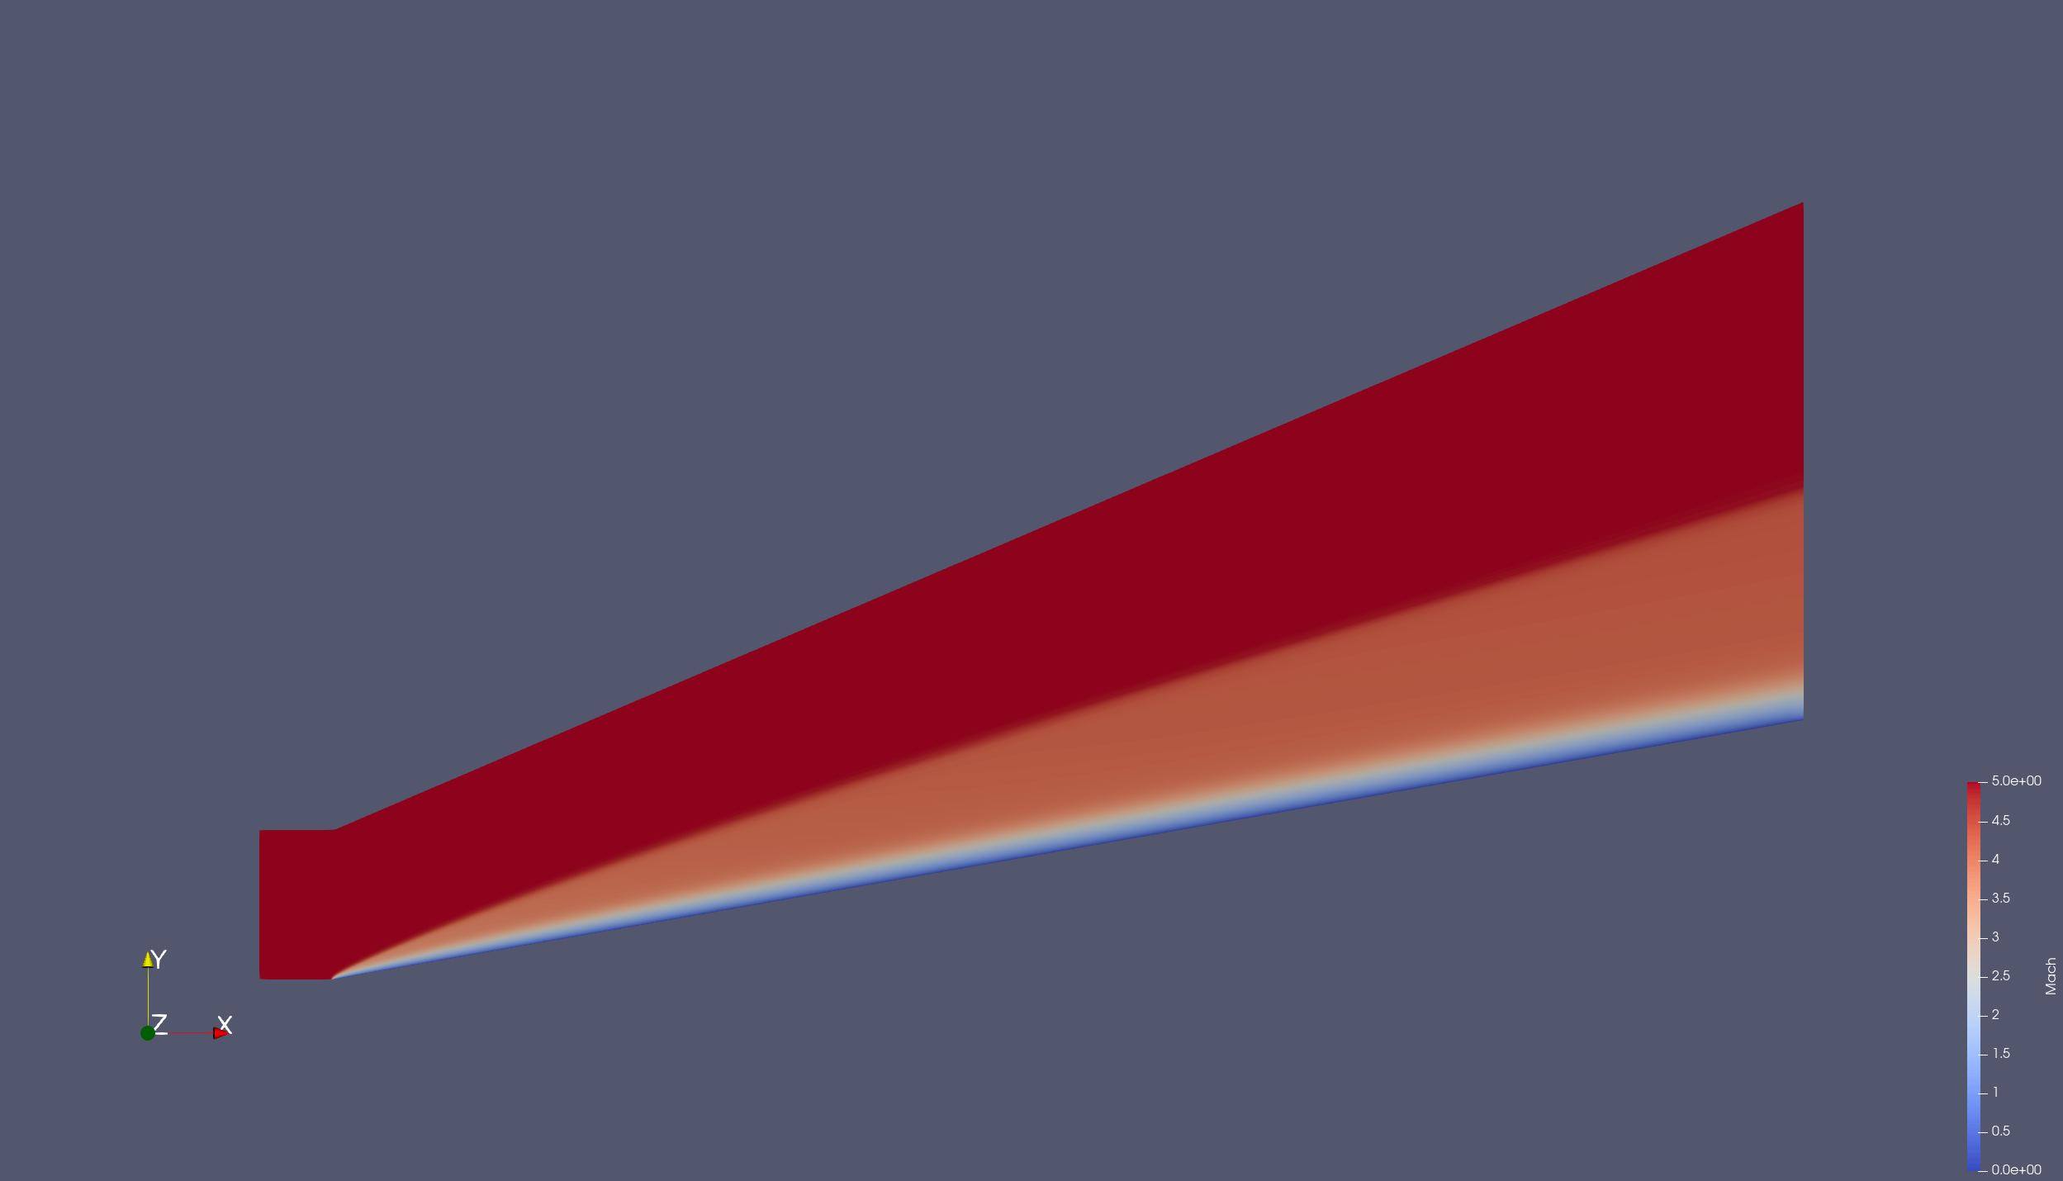
High-Speed Flow over Frustum (RANS SA)
3D
2D Axisymmetric

Slide 5
Comparison of Surface Quantities

Slide 6
Low-Re Flow over Sphere (RANS SA)
Parameter | Value
Ma | 0.1
Re | 40
Issues with convergence of 2D case using Roe, solved by switching to JST (shown here)
2D Axisymmetric
3D

